Slide 1
Forecasting, Assessment and Analysis of Economic Climate of India
Srideep Kar
Under Guidance of, Dr. Chellatamilan T
SITE (School of Information Technology & Engineering)
Vellore Institute of Technology, Vellore, India
Email: Srideep.kar2019@vitstudent.ac.in

Slide 2
Abstract
Gross Domestic Product (GDP) of a country is a very important topic for the economy of the country. It depends on Agriculture, Manufacturing Industries, Electricity, Gas, water supply, transport, finance, real estate, etc. the complete growth of the economy of the country measured by GDP. In this paper, we train the past 10 years GDP of a specific country and predict the GDP of the upcoming year using the Data Mining prediction algorithm. The method predicts quickly, fairly and produces an acceptable prediction. the forecast is based on an assessment of the economic climate in individual countries and the world economy, using a combination of model-based analysis and expert assessment, measured in growth rates compared to the previous year. In this paper the GDP Gross Domestic Product forecast based on Autoregressive model. In this Project I am using a dataset which contain 4 tuples population growth, Literacy Growth for adult, Merchandise exports, Merchandise imports and GDP of India. The data set contain the data of the above tuples from 1897-2020.

Slide 3
Objectives
Predicting the GDP (Gross Domestic Product) of India
Forecasting the upcoming economic climate of India using best fit algorithm among Linear Logistic Regression Model, Random Forest Model and SVM (Support vector Machine Model).

Slide 4
Literature survey
Predicting Gross Domestic Product Using Autoregressive Models by John Roush, Keith Siopes, Gongzhu Hu.
Prediction of Gross Domestic Product Development by Takagi-Sugeno Fuzzy Inference Systems by Vladimír Olej , Jirí Krupka
China's Gross Domestic Product Forecast Based on the Grey System Theory by Yawei Wang, Rei Wang.
A Heuristic Network for Predicting the Percentage of Gross Domestic Product Distribution by Emmilya Umma Aziza Gaffar, Irwan Gani.

Slide 5
Architecture & Design
In this project SVM(Support Vector Machine) algorithm is used for prediction the Gross Domestic Product value.
The Dataset contains past 125year’s Gross Domestic Product, Population, Literacy Rate, Import, Export including 2020(May).
In the case of pre-processing of data, these are several data of GDP column in the dataset contains negative value, in that case we replace those negative values with the mean value of total GDP because GDP never could be negative.
After all the proposed work we have plot a graphical representation of predicted data and original data to understand the accuracy more clearly.

Slide 6
Diagram
Input Dataset
Data Pre-Processing
Statistical Report Analysis
Train and fit the Model

Slide 7
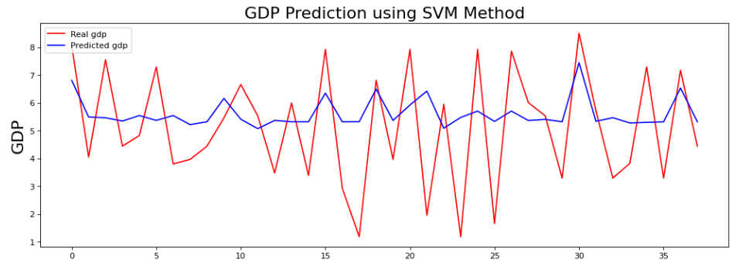
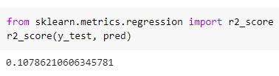
Result
Above graph (left side) is the final result of the proposed working model. The blue curve denotes the predicted GDP and the red curve denotes the real gdp. And in the right side we have calculated the score of the model of SVM.

Slide 8
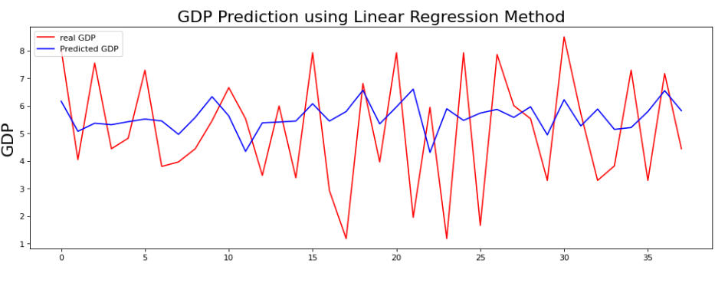
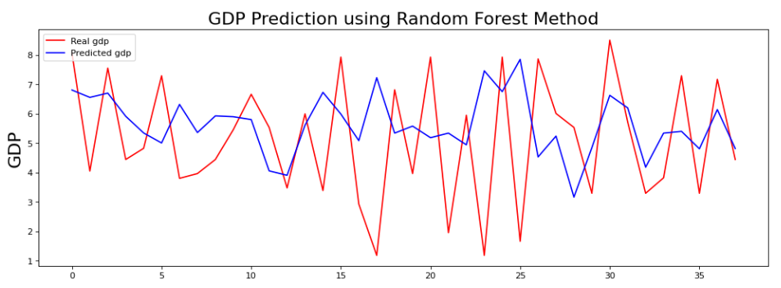
conclusion
Linear logistic regression
Random Forest
SVM (Support Vector Machine)
 | Score | RMSE
Linear Logistic Regression | -0.05354441151664079 | 2.112787828800119
Random Forest | -0.36890404197095483 | 2.4083298324721274
SVM (Support vector Machine) | 0.10786210606345782 | 1.9442202212384223

